Slide 1
CACHING
ASP.NET Web API
Making your API Consumer Experience the Best

Slide 2
Agenda
01
03
02
04
Details of Caching
Server-side Caching
Architecture
Client-side Caching

Slide 3
—Mark Twain
“Data is like garbage. You’d better know what you are going to do with it before you collect it.”

Slide 4
Introduction
Caching
Cached data typically includes multimedia such as images, files, and scripts, which are automatically stored on a device the first time a user opens an application or visits a website.

Slide 5
01
Details of Caching
Caching
You can enter a subtitle here if you need it

Slide 6

Knowing how to cache data is hard
The hard part is knowing what data to cache and for how long.

Slide 7
02
Architecture
Caching
You can enter a subtitle here if you need it

Slide 8

In your ASP.NET Web API…

Slide 9
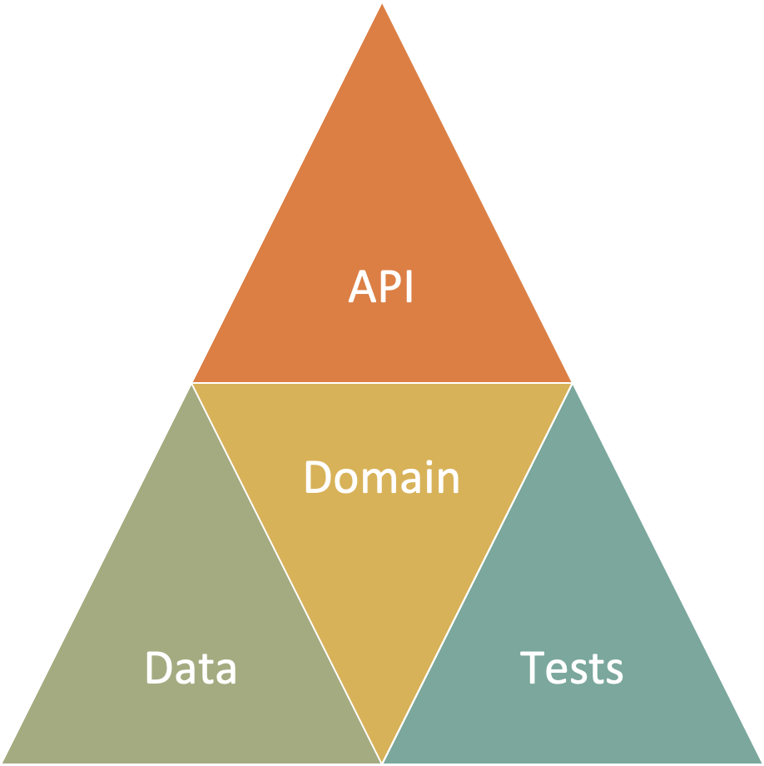
My thoughts on caching…

Slide 10
03
Server-side Caching
Caching
You can enter a subtitle here if you need it

Slide 11
In-memory Caching
ASP.NET Web API in-memory caching optimizes performance by storing frequently accessed data in memory, reducing database load and enabling quicker response times for users.

Slide 12
Code
Caching
In-memory Caching

Slide 13
Output Caching
ASP.NET Web API output caching improves response speed by storing server responses, minimizing repetitive processing, and delivering instant data retrieval for identical requests.

Slide 14
Code
Caching
Output Caching

Slide 15
Distributed Caching
ASP.NET Web API distributed caching ensures high availability and scalability by sharing cached data across multiple servers, ideal for load-balanced and cloud-hosted applications."

Slide 16
Distributed Caching
Distributed caches can improve the performance and scalability of ASP.NET Core apps, especially when hosted in the cloud or a server farm.
Cached data is coherent on all web servers. Users don't see different results depending on which web server handles their request
Cached data survives web server restarts and deployments. Individual web servers can be removed or added without impacting the cache
The source data store has fewer requests made to it (than with multiple in-memory caches or no cache at all)

Slide 17
Local Redis Cache
SQL Server Cache
Azure Redis Cache
Amazon ElastiCache
Google Cloud Memcache
Distributed Caching

Slide 18
Code
Caching
Distributed Caching

Slide 19
Advanced Topics
Explore advanced ASP.NET Web API caching strategies to optimize web applications for peak performance and reliability.

Slide 20
Paging
Rate Limiting
Some Additional Topics for Better UX

Slide 21
04
Client-side Caching
Caching
You can enter a subtitle here if you need it

Slide 22
Response Caching
Utilize ASP.NET Web API client-side response caching to offload server tasks, ensuring faster data delivery and a streamlined experience directly from users' devices.

Slide 23
Response Caching
Directs Caching on the consumer side
HTTP 1.1 Caching specification
Attribute on Controller or Action
[ResponseCache(Duration = 60)]
Response Header:
Cache-Control: public,max-age=60
[ResponseCache(Location = ResponseCacheLocation.None, NoStore = true)]
Response Header:
Cache-Control: no-store,no-cache
Pragma: no-cache

Slide 24
Code
Caching
Response Caching

Slide 25
Client-Side Caching
Implement client-side logic to handle ASP.NET Web API caching: detect cache headers, store responses efficiently, and refresh data to maintain sync with server updates.

Slide 26
Blazor ProtectedLocalStorage
Javascript Old School: Cookies
Javascript New School: Web Storage
Javascript New School: IndexedDB
NodeJS: node-cache
Client-side Caching
From HTTP Response
Notes:
The Web Storage API provides a mechanism for storing and retrieving smaller, data items consisting of a name and a corresponding value. This is useful when you just need to store some simple data, like the user's name, whether they are logged in, what color to use for the background of the screen, etc.
The IndexedDB API provides the browser with a complete database system for storing complex data. This can be used for things from complete sets of customer records to even complex data types like audio or video files.

Slide 27

Code Example

Slide 28

GITHUB REPO HAS ALL OF THE CODE
Caching
https://github.com/cwoodruff/web-api-caching-talk

Slide 29
Thanks!
Caching
Do you have any questions?
cwoodruff@live.com
616 724 6885
@cwoodruff

